Slide 1


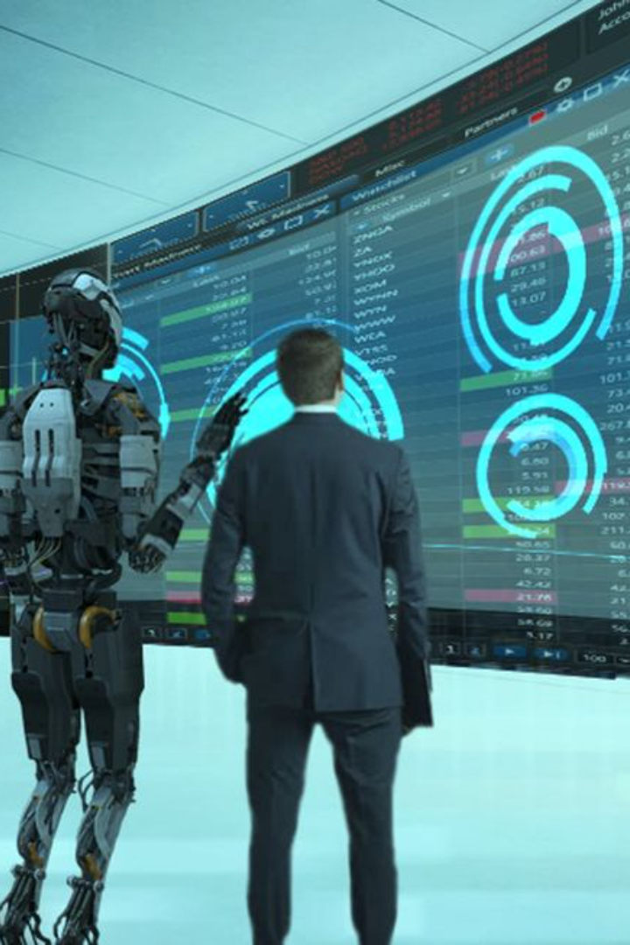
Introduction to Artificial Intelligence
Artificial Intelligence (AI) refers to the simulation of human intelligence in machines that are programmed to think and act like humans. It involves the creation of algorithms that enable machines to learn from data, recognize patterns, and make decisions.

Slide 2
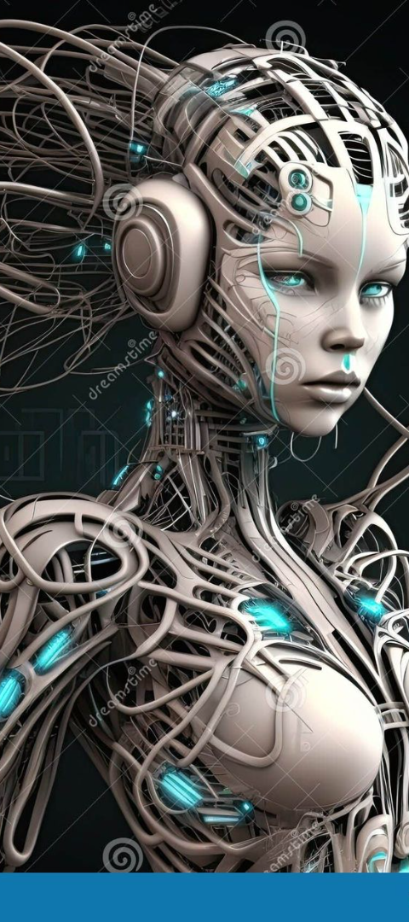
Defining Artificial Intelligence
Versatility
"Versatility means being able to do many different things or being suitable for various purposes. It's like being flexible."
Complexity
Complexity means things that have many parts or are difficult to understand because they are made up of different pieces.
Impact
AI has the potential to revolutionize various industries and significantly impact human society.

Slide 3
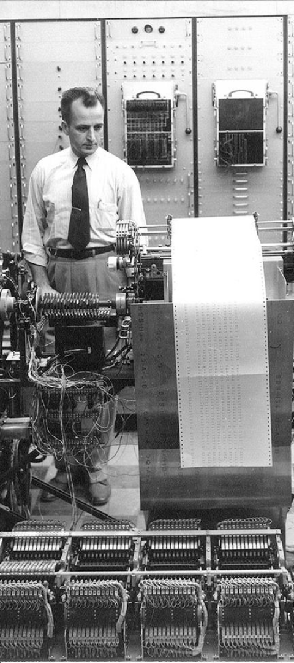
Brief History of AI
1
1950s-1970s
The foundational concepts and early development of AI, including the work of pioneers like Alan Turing and John McCarthy.
2
1980s-2000s
A period of variable progress and setbacks, characterized by a shift from symbolic AI to neural networks and machine learning.
3
2010s-Present
Rapid advancements in AI technology, fueled by big data, computing power, and breakthroughs in deep learning.

Slide 4
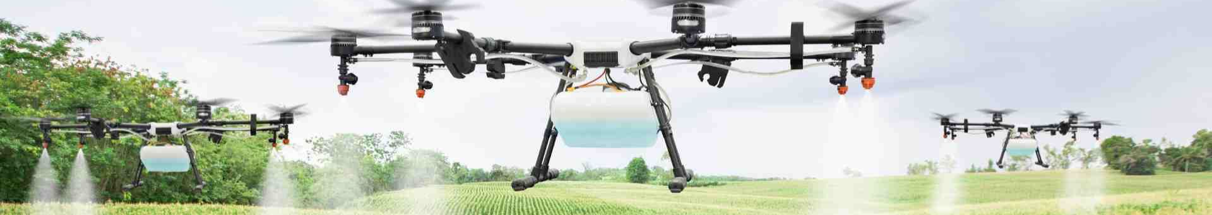
Importance of AI in Today's World
Driving Economic Growth
Healthcare Advancements
Shaping Future Technologies:
AI drives innovation, productivity, and economic growth by enabling automation and intelligent decision-making.
AI plays a critical role in medical imaging, drug discovery, personalized treatment plans, and predictive analytics.
"Robotics: Machines for tasks, like factory robots. Autonomous Systems: No human control, e.g., self-driving cars. Human-Machine: Interact, like voice commands."

Slide 5





Why Should We Use AI Tools?
Efficiency and Automation
AI tools can automate repetitive tasks, reducing the need for manual labor and speeding up processes. This efficiency allows organizations to accomplish more in less time, leading to increased productivity.
Improved Decision Making
AI tools can analyze vast amounts of data quickly and accurately, providing insights that humans might overlook. By leveraging AI for decision-making processes, organizations can make more informed and data-driven choice
Scalability and Adaptability
AI tools are good at dealing with a lot of information all at once. So, if there's a huge amount of data to analyze, like customer preferences or production details, AI can manage it without getting overwhelmed.
Cost Savings and Resource Optimization
By making things automatic and organizing tasks better, AI tools help companies spend less money and use their resources smarter. For example, AI can help use less energy or make sure that products get from one place to another in the best way possible, which saves time and money.

Slide 6
Applications of AI
DALL-E
GPT-3
OpenCV
DALL-E is an AI model created by Open AI. It's like a magic drawing tool that can take written descriptions and turn them into pictures. You can tell DALL-E what you want to see, like "a cat with wings" or "a house made of clouds," and it will create an image of that for you. It's really good at coming up with imaginative and creative pictures based on the words you give it
GPT-3 stands for "Generative Pre-trained Transformer 3." It's like a very smart robot that knows a lot of things about language. it's really good at understanding and generating human-like language. People use it for things like writing stories, answering questions, translating languages, and lots more. It's one of the most advanced language models we have right now!
OpenCV, short for Open Source Computer Vision Library, is a tool that helps computers understand and work with images and videos. Imagine you have a bunch of photos, and you want to do things like find all the faces in them or figure out if there's a cat or a dog in each picture. It can also help in more complex tasks like recognizing handwritten text or even detecting emotions on people's faces.

Slide 7
Future of Artificial Intelligence
75B
6.7M
87%
Economic Impact
Career Opportunities
Industry Adoption
The projected annual economic impact of AI by 2025, driven by increased productivity and innovation.
Anticipated new job openings in AI-related fields, creating diverse career paths and opportunities.
The percentage of global organizations planning to adopt AI for business advantage and transformation.

